Slide 1

Performance Chemical Company -Frac Programs
Introduction to PCC’s customized frac chemical programs, analytical monitoring and flagship case studies

Slide 2

PCC – Case Studies
January, 2012 PCC engaged in an intensive case study that included bacterial monitoring of source water and fluid throughout the frac process. The case study was a result of the customer wishing to better understand the integrity of the frac water throughout the entirety of the process and the resulting effects on the producing well. Results inferred an immediate need for an in depth program that could be customized to each area, formation and company’s needs.

Slide 3
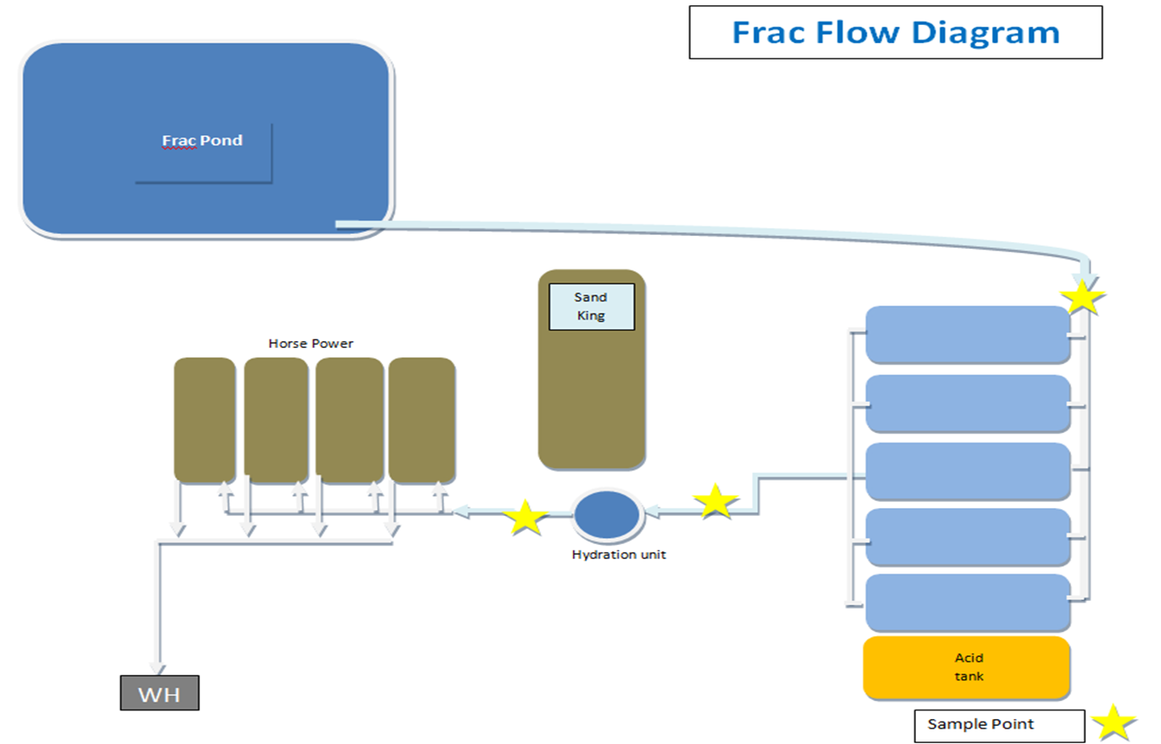

PCC – Case Study Results
Water Samples were pulled from the frac pond and the following points in which serial delusion bottles were inoculated four bottles deep:

Slide 4
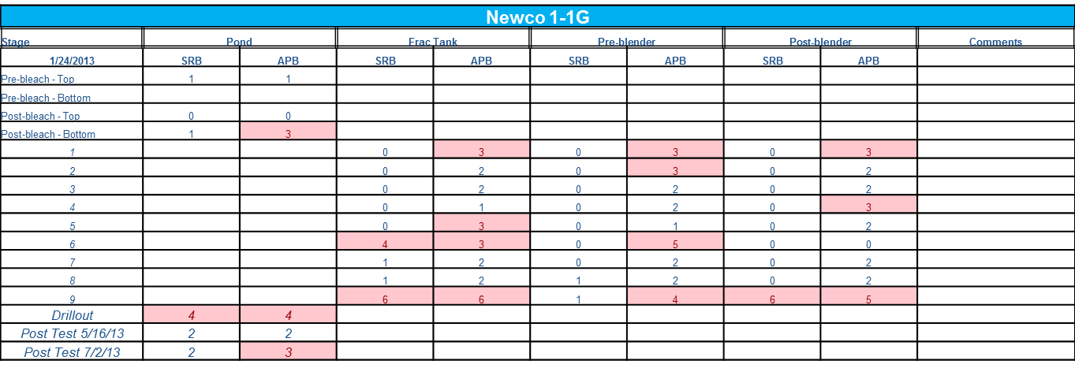
PCC – Case Study Results
Example of Inoculated Serial Delusion Bottle’s Results:

Slide 5
PCC – Case Study Results
Previous slide’s results indicated the following:
  Although frac ponds were treated with bleach, the treatment was inconsistent and did not provide a continuous clean water source.
  Although frac equipment was believed to be clean, visual inspection of equipment and serial delusion bottle results proved otherwise.
  Although the frac company was providing a biocide, it proved to be ineffective once the producing well was tested.

Slide 6
PCC – Pre-Program Testing
The following testing will be completed prior to building any frac chemical program:
  Kill study of available source water using a range of PCC’s water treating products. This will determine the appropriate treatment amount.
  Complete Water Analysis of source water and nearby producing wells. This will provide information needed to create an effective scale inhibition program.
  Projected production numbers of the wells that will be frac’ed. this will provide information needed to project treatment life once the well is put online.

Slide 7
PCC – Standard Frac Program
  The following products are utilized in PCC’s most effective frac chemical program:
    Pro-Solve 900 – Stabilized Chlorine Dioxide
    Pro-Hib 320 – Polyacrylate Scale Inhibitor
    Pro-Hib 355-G – Complex Biocide
    Dry-Chem 1000 – Biocide Bags

Slide 8
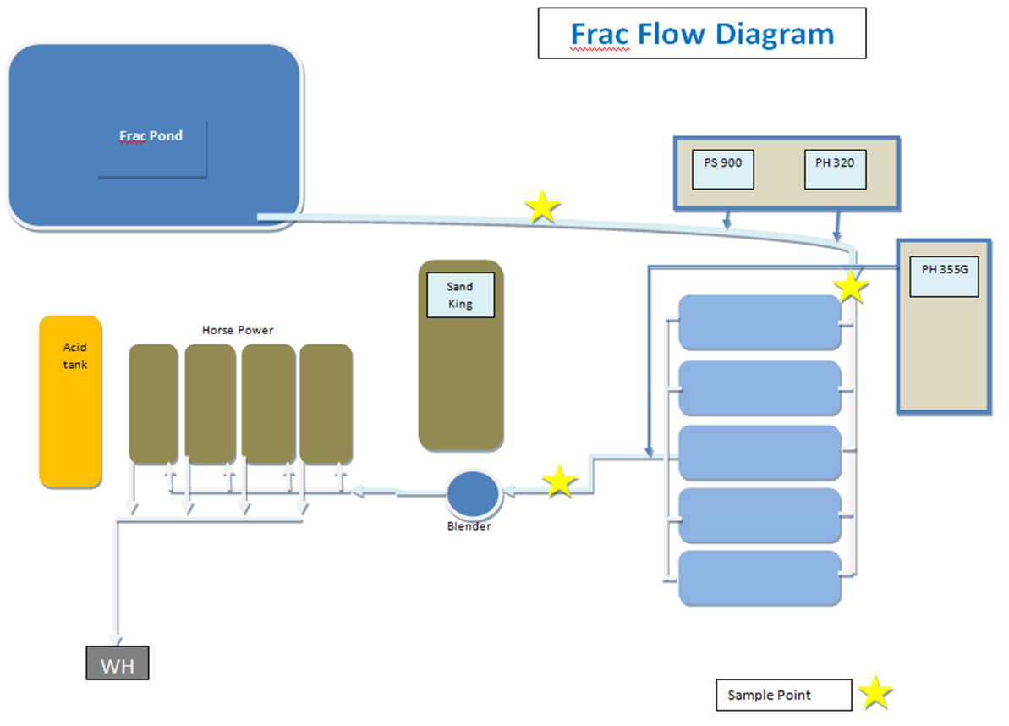
PCC – Product Injection Points

Slide 9
PCC – Product Placement
  The following products are strategically placed for maximum treatment results:
    Pro-Solve 900 – Initial water treatment (High pH)
    Pro-Hib 320 – Provides scale inhibition for the initial life of the well (±180 days) and is injected following the PS-900 due to the boost of activity from the variance in pH.
    Pro-Hib 355-G – Glut – Quat product that acts as a polisher of any contamination occuring through the frac equipment and provides a long term downhole treatment (±180 days).
    Dry-Chem 1000 – Quick dissolving bags containing a dry water treating product are dropped into each holding tank to protect against initial contamination due to unclean tanks and increased contamination during down time.

Slide 10
PCC – Monitoring Program
  The following monitoring program was created to prove the effectiveness of the program and provide information to adjust the program when needed:
    Pre Frac CWA and SDB’s – Provides a complete profile of the source water
    Frac Bacterial Monitoring – Serial delusion bottles will be inoculated from samples pulled from three locations (Pre 900 – Post 900 – Post 355G). This will provide data and trends needed in program adjustments and monitoring.
    Post Frac CWA, SDB’s and SI Residual – The producing well will be monitored once online by completing a CWA for a complete profile, serial delusion bottles which will determine the effectiveness of the water treatment program and a scale inhibitor residual (PH-320 is formulated with a phosphate tag to provide residual monitoring).

Slide 11
PCC – Frac Stage Bacteria Report

Slide 12
PCC – Pre – Post Frac Data Sheet

Slide 13
PCC – Reports
  The following reports will be complete and readily available when working with PCC:
    Projected Breakdown – When PCC receives a frac program with stage fluid breakdowns the customer will receive a projected breakdown of product amounts per stage and totals. (Each Job)
    Final Breakdown – PCC provides a detailed breakdown of products pumped to the data van at the completion of each stage and job.
    Frac Stage Bacteria Report – As seen previously, PCC will provide a detailed report of bacteria counts from each stage throughout the job. (Monthly)
    Pre – Post Frac Data Sheet – As seen previously, PCC will provide a data sheet that includes CWA’s of source water and produced water, bacteria counts from source water and produced water and the scale inhibitor residual. (Monthly)

Slide 14
PCC – FAQ’s
  If the biocide is as effective as you say, why is the PS-900 used?
    The water treating qualities of the PS-900 provides the initial water treatment that allows PCC to treat with PH-355G at a lower rate than without PS-900 and still remain effective. This creates a more economically feasible program. Think of PH-355G as a polisher that provides long term protection.
  Are there alternative products and programs?
    Yes – PCC will collaborate with their customers to create an optimal program that reaches the needs of the customer. PCC will not agree to a program that they do not believe will be effective.
  What is the cost per barrel?
    Cost per barrel will vary depending on the program. Once a treatment rate is determined for each product based on the pre-program data, and desired products and programs are put in place, a cost per barrel can be determined. PCC’s goal is to be within 5% of the projected breakdown (to date, 3% is PCC’s average variance).
  What other completion chemical programs are available?
    PCC highly recommends using a chemical program for the drill out process. This program will be created in conjunction with the company’s current drill out program. It includes treating the circulation water, cleaning the down hole equipment and providing the initial corrosion inhibitor coating immediately after the last plug is drilled and sweep is completed.

Slide 15
PCC – Frac Chemical Programs
  Questions?

