Slide 1
Performance Chemical Company
Dry-Chem Application

Slide 2
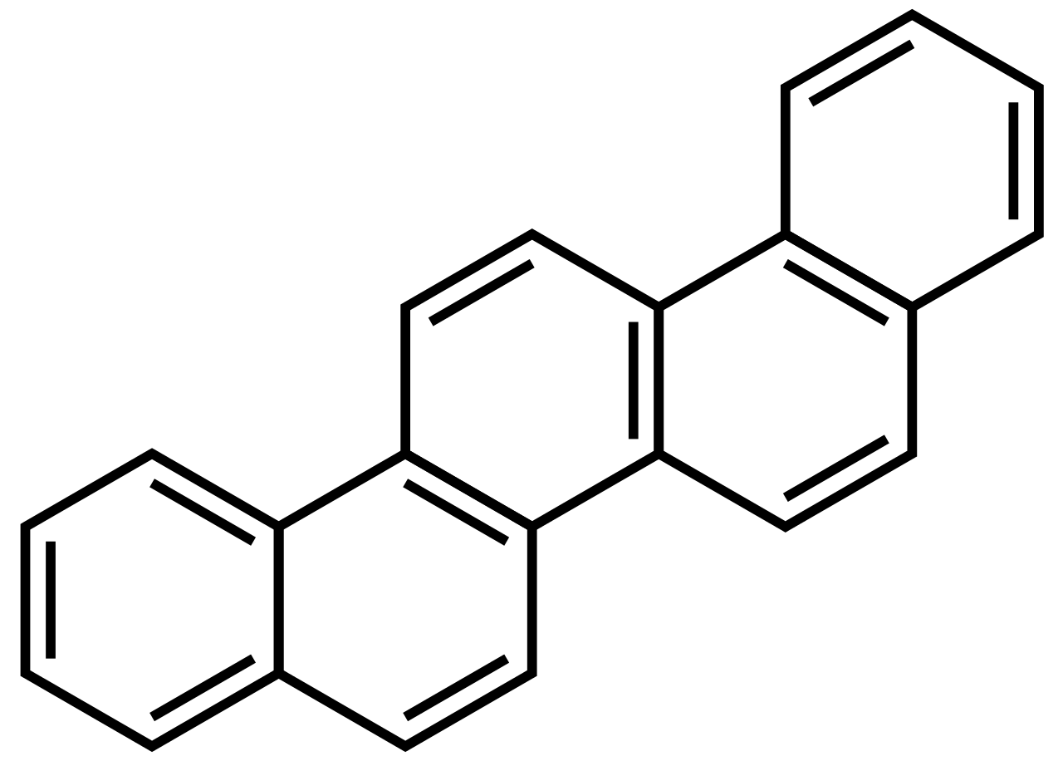
Contents
Who Performance is…
Performance Dry-Chem
Services Provided
Treatment Recommendation
Analyzing LOE

Slide 3
Who We Are
Service
Product
Personnel
PCC’s intent is to ensure that the deployment of our chemical program is effective and efficient. The true value of our program is the dedicated and consistent service.
Striving to stay ahead of the game, our Dry-Chems were developed to provide a cost effective approach in an unconventional treatment method. We realize how crucial our customers LOE is in the grand scheme, so we develop our products with that purpose.
PCC realizes that we are only as good as our field representation and our supporting staff. Our personnel are competently trained in order to provide the service and solutions our customers need.
Notes:
Service: the Prices of our service are always included into the price of our product, so you will never see a separate invoice for service or labor.

Slide 4
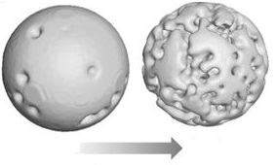
Dry-Chem
Producing the product
Our Dry-chem products were designed to be different than the industry granular products that are coated.
Creating a porous particle allows chemical to be embedding within it.
With minimal surface area, the chemical product releases into solution slowly.
No wax coatings
4

Slide 5
Dry Chem
Conventional Treatment
Dry-chem Treatment
Liquid treatment stops here
Dry-chem treats from the bottom up

Slide 6
Application & Service
For vertical wells, the dry product is mixed into a slurry and then pumped down the back side.
The product falls at 1000 ft/hr, and then settles in the rathole.
A shut in period to allow the product to drop is required, based on the total depth. Through this method, treatments can be designed to last for 30 to 90 days!
All Laboratory, field, and analytical services are included with treatment. Consistent testing/sample collecting will be scheduled as deemed necessary.

Slide 7
Treatment Recommendation
Paraffin Treatment
Clean-up
Product: PS-411
On known problems wells, PCC recommends a Paraffin Clean-up circulation before our dry-chem is applied. Recommended 12-24hr circulation time.
55 gallons treatment if FL is 250ft or less above the pump
Scheduled Treatment
Product: DC-451
A unique blend of dispersants and penetrants to not only help break up any paraffin but also keep paraffin from forming at all. Pumped in a slurry down the backside.
Typical loadings of 250 to 500 ppm – depending on paraffin severity

Slide 8
Treatment Recommendation
Scale Control Treatment
Scale Treatment
Product: DC-229
Soluble scale inhibitor, high calcium tolerant phosphonate blend of field proven inhibitors for prevention of calcium carbonate and sulfate. Recommended treatment at 60ppm
Product: DC-230
Soluble scale inhibitor of neutralized poly-acid to inhibit carbonate, sulfate, and barium scales by stopping nucleation and crystal growth. Recommended treatment at 60ppm
Notes:
*Make sure to print out all PDSs

Slide 9
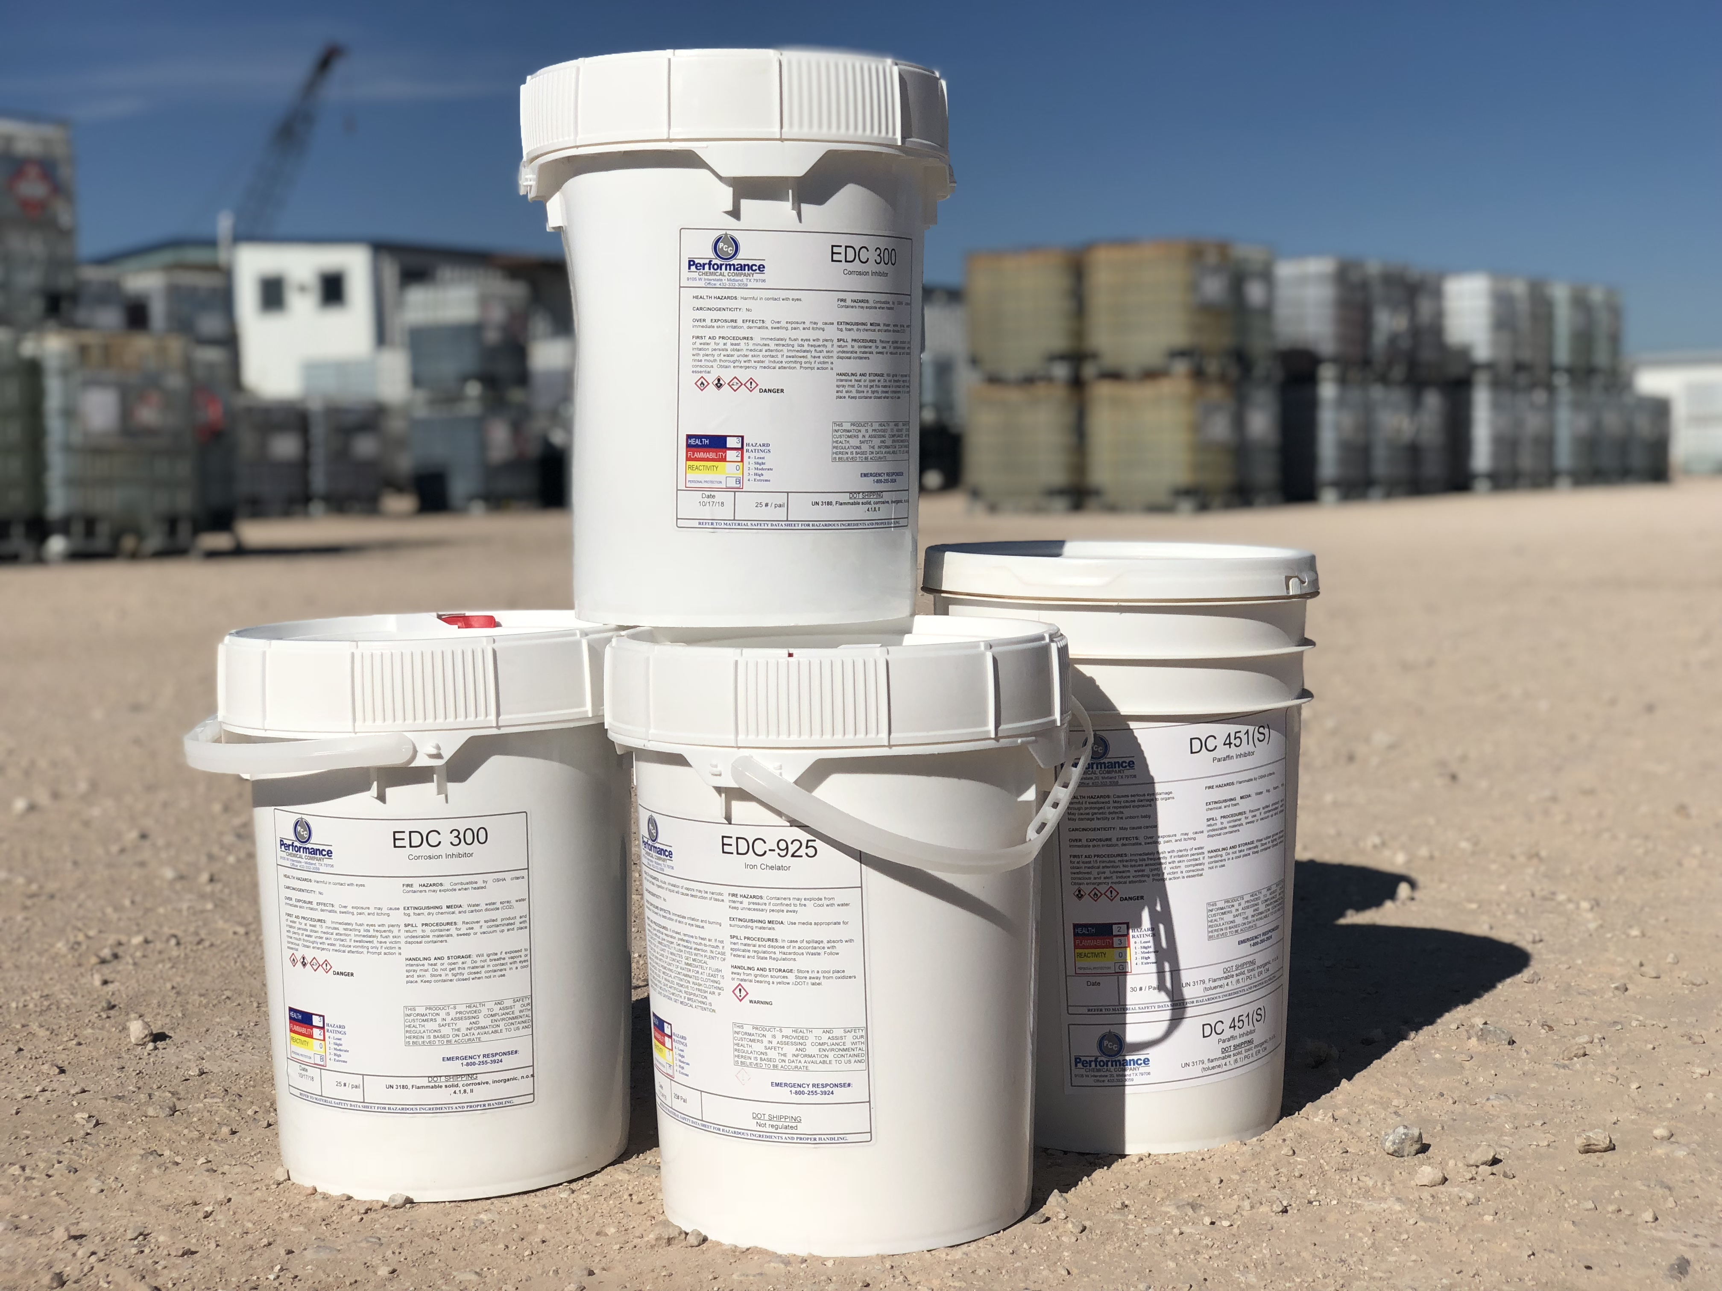
Treatment Recommendation
Corrosion and Iron Control Treatment
Corrosion Treatment
Product: DC-300
Corrosion inhibitor effective against H2S and CO2 corrosions. It is effective over a wide range of brines and temperatures up to 250 °F. Recommended treatment at 80ppm.
Iron Control Treatment
Product: DC-925
Water-soluble formulation which has been shown as a good iron chelator. Recommended treatment based on Iron Severity.
Notes:
*Make sure to print out all PDSs

Slide 10
Focusing on LOE
LOE cost are directly tied to PCC’s basic product application selection process. We understand the importance of the cost of maintaining the well.
Hot Oiling Treatments
Scale Clean-ups
Pump Failure
A Chemical Program that works
Notes:
Go Over Case Study

