Slide 1
Dry-Chem
Formulated to Perform

Slide 2
The Development
Goal: Develop a more effective and efficient treatment that will lower TCO.
How to treat for scale and paraffin in a proactive method that will lower cost and prevent failures?
Key components:
Product selection
Treatment prevention through crystal modifier or scale inhibition
Product placement
Needs to treat the paraffin or scale before it starts to form
To prevent the issue there must be a continuous treatment without high set up cost or a squeeze.

Slide 3
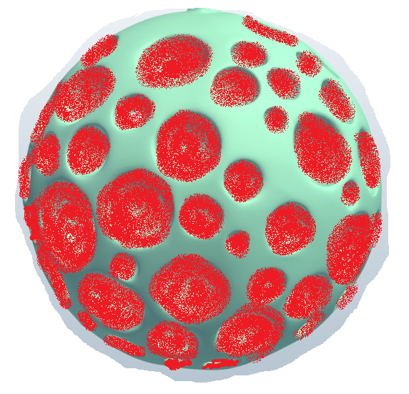
Dry-Chem Products
A highly concentrated product that is designed to slowly release
While many of the industries granular products are coated our formulated chemistries are absorbed into this product
The product is manufactured with a porous silica that can be loaded with specialty chemistries and designed to release slowly into the fluid during production
With minimal surface area the product slowly releases into the fluid
Designed to be utilized in vertical production wells
Mixed into a slurry and pumped down the back side
Treats from the wellbore up ensuring entire fluid column has been conditioned
Treatments designed for 60-180 day intervals
Designed to be utilized in the completion process
Added during the sand stages
Pushed far into the formation
Provides longer lasting inhibition

Slide 4
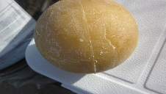
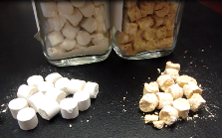
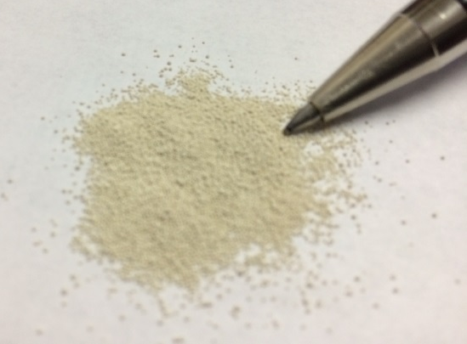
Dry-Chem Products
Innovative treatment methods
Dry-Chem Product Line
Same chemistries through a different form.
Concentrated product designed for slow release
Conventional liquids are 20-30%
Solids are 60-80% product
All products can be formulated into a Dry Product
Paraffin, Scale, Corrosion, Biocide, H₂S scavenger…
Any shape and form

Slide 5
Understanding the Application
Understanding well characteristics is a key component in developing comprehensive knowledge of well problems, that then lead to developing effective resolutions.
Fluid analysis
Lift system
Pump placement
Feet of pay zone
Production numbers
Fluid level
History
What are the past failures?
Where is the problem?
Pressures
Realize the advantages and disadvantages of each treatment method.

Slide 6
Conventional Vs. Dry-Chem
Conventional Treatment Methods
Batch Treating
Corrosion Treating Slug on a frequent schedule
Low cost
Continuous Treatments
Provide a constant feed of product for the well
Advantages
Specialty Treatments
Squeeze (Paraffin & Scale)
Circulation (Paraffin & Scale)
Advantages
Disadvantages
Removal of inhibitor
Missed treatments
Lost production
Continuous inhibition
Disadvantage
Cost of equipment
Repair and maintenance on equipment
Advantage
Duration of treatment
Disadvantage
Cost of initiation treatment
Efficiency to adhere to formation
Advantage
Minimize number of treatments
Disadvantage
Reactive
Contact time
Weather
Roads
Introduction of foreign water
Product placement
Not economical on many wells
Hot Oil
Advantages
Disadvantages
Quick relief
Removed light aromatics leaving heavy aromatics
Damage to wellbore through paraffin buildup

Slide 7
Conventional Vs. Dry-Chem
There are many advantages to the utilization of Dry-Chemistry in production wells
Cost effective
Provides the benefits of continuous treatment with the cost comparable to Truck Treating
Minimum number of treatments
30 days up to 365 days
Minimize lost production - Many old wells lose their production after Truck Treatments
Environmental Footprint
Reduction on trips to the well
Reduction in man hours on leases

Slide 8
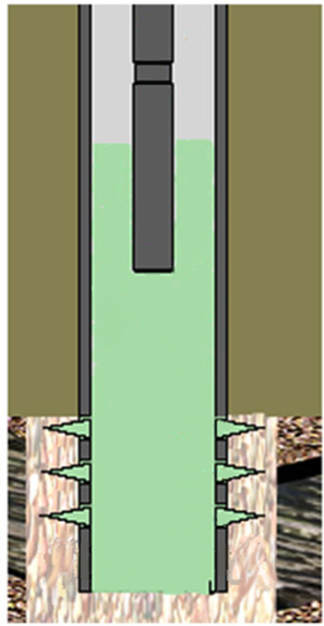
Conventional Vs. Dry-Chem
Annulus
Liquid Treatment Path
Liquid treatment stops here
Product slowly dissolves giving you a prolonged continuous treatment
Casing Perfs
Dry Chemistry treats from the bottom up

Slide 9
Product Selection
Typically wells are treated with Pellets or granular
Pellets
Easy to handle and treat during well pulls
Hard to treat down the casing without reworking the wellhead configuration
Can stack up on
TAC
Casing sleeves
PCC’s pellets are not wax but rather the granular product formed into a pellet

Slide 10
Product Selection
Downhole assemble with TAC
Some product will make it down into the fluid
There is a chance that it could get hung up on the TAC

Slide 11
Product Selection
Granular
A highly concentrated product that is designed to slow release
With minimal surface area the product slowly releases into the fluid
Designed to be utilized in the completion process
Added during the sand stages
Provides longer lasting inhibition
Its form has provided PCC with the ability to utilize it on production wells given
Its ability to be mixed in a slurry and pumped down the annulus
Multiple products can be mixed together
Oil soluble and water soluble
With its small size it can easily pass through minimum clearance areas
TAC
Casing Sleeves

Slide 12
Product Placement
The granular in a wellbore

Slide 13
Product Placement
The granular in a wellbore
Slowly release
Provides continuous feed from the bottom up
The crystal modifier of the DC 451 (paraffin) is then able to inhibit paraffin crystal before they form
The DC 229/230 (scale) is able to continuously inhibit scale without the cost of a squeeze or continuous treatment
DC WT (water treat) can clean the rat hole of microorganisms

Slide 14
Production Case History #1
Paraffin – Vertical Wolfberry wells
High paraffinic wells
28% paraffin in grindout
Cloud Point at 70 °F
Hot Oil every month - $550/well
Emulsions at each facility
Tank bottoms saturated with paraffin and iron sulfide
Averaged $3,000-$6,000 per month in Emulsion Treating plus Hot Oiling tank bottoms
Started treatments on a 5 well trial package
$284-$350/well every other month
Monthly cost of $142-$175/well

Slide 15
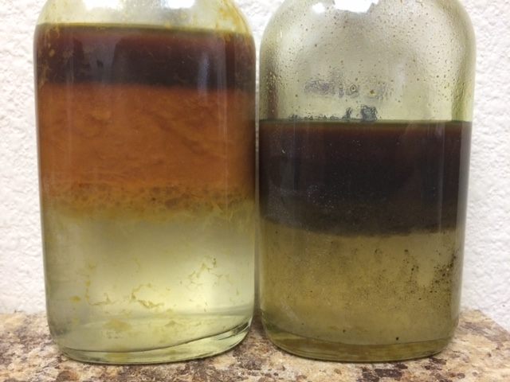
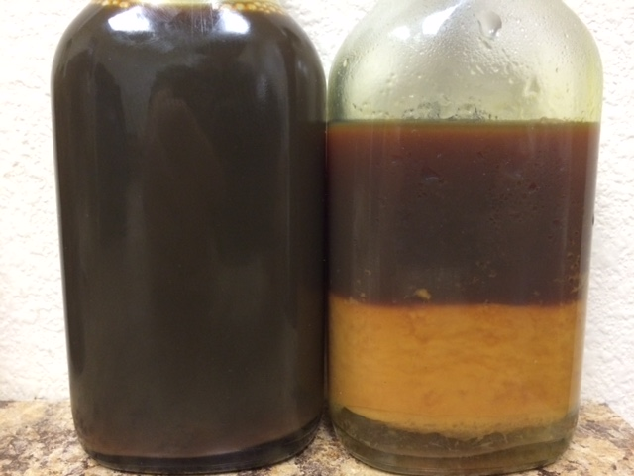
Production Case History #1
Paraffin – Vertical Wolfberry wells
High paraffinic wells
1.5% paraffin
No paraffin build up on coupon
DC vs H.O. cost
Provided a savings of $1,945 per month on the 5 wells
Emulsions turned off Emulsion Breaker
Slug tank bottoms for iron sulfide as needed
Average of $3,000 per month savings
The 5 well trial package
Total savings of $4,945 per month
Provided producer with ~$60,000 per year!!
Lead to PCC treating the entire lease

Slide 16
Production Case History #2
Multiply failure wells in an area with high gas production preventing continuous inhibition. 3 wells
Experienced bacteria corrosion, scale precipitation and paraffin build up
9 failures in 5 months
Treatment design
EOW Truck Treating with Corrosion Inhibitor
Dry-Chem products
DC 229 to treat scale - 5 ppm based on water production
DC WT to condition the water against Microbial Induced Corrosion (MIC) – 100ppm based on water production
DC 451 to treat paraffin – 300ppm based on oil production
Monitored with residuals and wellhead grindouts

Slide 17
Production Case History #2
After the treatment
The well experienced a total of 5 failures in course of a year with none of them having signs of paraffin, scale or microbial induced corrosion
All failures were rod wear which was corrected over the next year
PCC was effective at cutting the failures from 18 a year to 5 a year
$50,000 per failure
13 failure preventions = $650,000 savings

Slide 18
Tank Bottom Treatment
Tank bottom treating
4” Paraffin Balls
Are designed to address paraffinic tank bottoms
This design allows product to fall to the bottom
Its round form gives it the ability to move around in the tank bottom
Slowly disperses into the fluid breaking the emulsion pad and dissolving the paraffin, then disperses it into the oil
Ideally used when a bottom is forming and the tank is low
This allows for agitation as the oil flows into the tank.
Treats the tank for 2/3 the price of liquid products

Slide 19
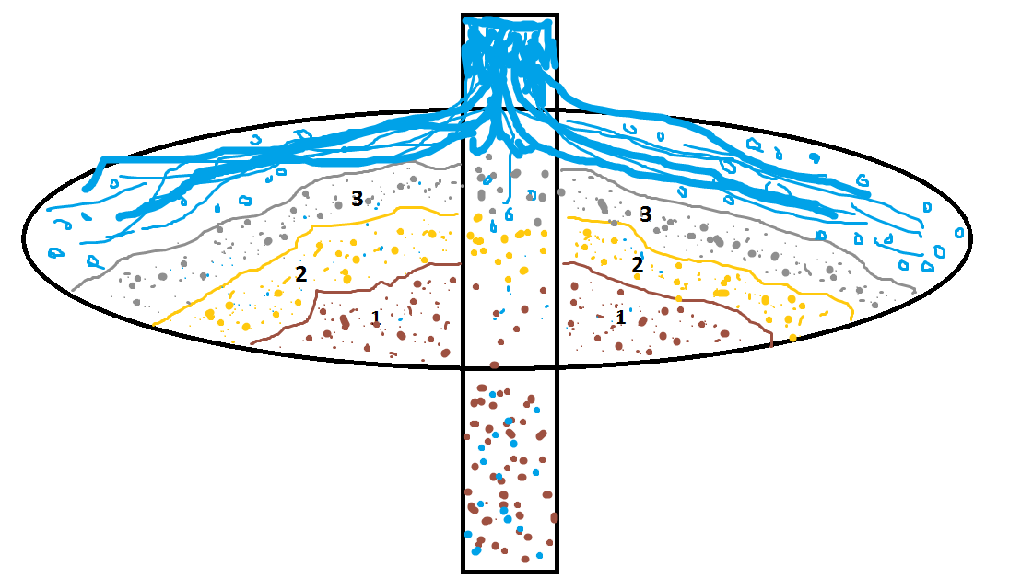
Stimulation Product Placement
DC 229
DC 451

Slide 20
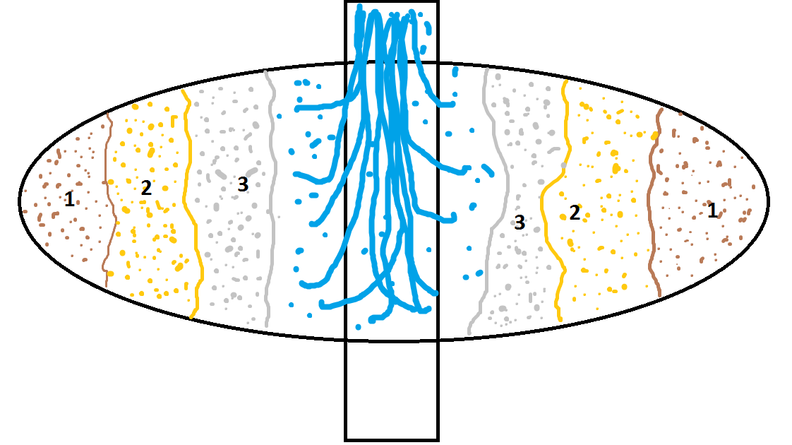
Stimulation Product Placement
Solid Chemical #1
DC 229
Solid Chemical #2
DC 451

Slide 21
Frac Scale Case History
The Problem
A West Texas Oil producer in the Delaware Basin was having severe Barium Sulfate scaling deposition problems in their laterals. This was leading to costly downtime and remediation through coil tubing cleanouts. They wanted to investigate the possibility of a chemical treatment program which allow them to flow back without the devastating scale that was inhibiting their production

Slide 22
Frac Scale Case History
Non-Scale inhibitor Program Cost Analysis:
Coil tubing cost when well fails = ~$340,000
Lost production 3-14 days due to down time of 400bbl/day at $55/bbl = $22,000 per day
Maintenance chemical program = ~$30,000 over 24 months
Based on a production time of 24 months

Slide 23
Frac Scale Case History
PCC’s solution
PCC designed a comprehensive scale inhibition program that covers both aspects of a fracs scaling tendencies. PCC started with a liquid polymeric scale inhibitor, typically between 75-150 ppm. It was pumped to inhibit any incompatibilities between the frac water and the formation water. While this treatment can be successful it was offering only 6-10 months of proven protection (PO4) residuals.
To help prolong this treatment, PCC designed a dry chemical addition that would be pumped back into formation and slowly release. This provided a long continuous treatment protecting from the toe of the lateral to the wellhead. This treatment was treated at 30lbs per stage or ~60 ppm.

Slide 24
Frac Scale Case History
PCC’s Scale inhibitor Program Cost Analysis:
60 ppm dry chem @ 35 stages= ~$20,000
100 ppm liquid SI @ 35 stages= ~$15,000
Pumping and Labor @ 35 stages= ~$10,000
Total price per job @ 35 stages= ~$45,000

Slide 25
Frac Scale Case History
PCC’s Solution and Performance Results
PCC conducted a monitoring program that effectively tracked the performance of the scale inhibitors in the treated well.
The treatment delivered protection for 24 months before a maintenance chemical program was established.
Production remained stable and no cleanouts were necessary as the program had ensured flow assurance from the toe of the lateral to the wellhead for the entirety of the 24 month program.

Slide 26
Frac Scale Case History
Cost Analysis:
~ $340,000 - Cost of coil tubing job to restore production on well. This was completed on most all wells before PCC’s program was implemented.
~ $66,000-$300,000 - down time cost due to lost production (3-14 day clean out period)
~ $30,000 - Operating Costs associated with adding a scale/corrosion maintenance chemical program immediately.
Non-SI program over 24 months ~ $524,000
PCC’s SI Program over 24 months ~ $45,000
Total Cost reduction of ~$479,000

Slide 27
Product Selection
DC 229 – Formulated blend of Phosphonates
Broad Spectrum scale inhibitor, useful for calcium and magnesium carbonate, calcium and magnesium sulfate, barium sulfate and some iron sulfides and iron oxides.
pH stable – compatible with high pH frac fluids – does not interfere with cross-linked fluids
Slow dissolving release – to increase product effectiveness
High temperature stability ≥ 300°F
Residuals are traceable
Typical loadings of 20 to 100 ppm – depending on water composition
Mesh size similar to 40-70 mesh proppants

Slide 28
Product Selection
DC 230 – Formulated Polymeric scale inhibitor
Broad spectrum polymeric scale inhibitor, targeted mainly at inhibiting sulfate scales.
pH stable – compatible with high pH frac fluids – does not interfere with cross-linked fluids
Slow dissolving release – to increase product effectiveness
High temperature stability ≥ 400°F
Formatted with Phosphonate tag for residuals
Typical loadings of 20 to 100 ppm – depending on water composition
Mesh size similar to 40-70 mesh proppants

Slide 29
Product Selection
DC 451 – Formulated blend of Paraffin Penetrants and Dispersants
A unique blend of dispersants and penetrants to not only help break up any paraffin but also keep paraffin from forming at all
Reduction of paraffin can help ease flowback emulsions
It serves to retain the paraffin in the oil phase
Slow dissolving release – to increase product effectiveness
Typical loadings of 250 to 500 ppm – depending on paraffin severity
Mesh size similar to 40-70 mesh proppants

Slide 30
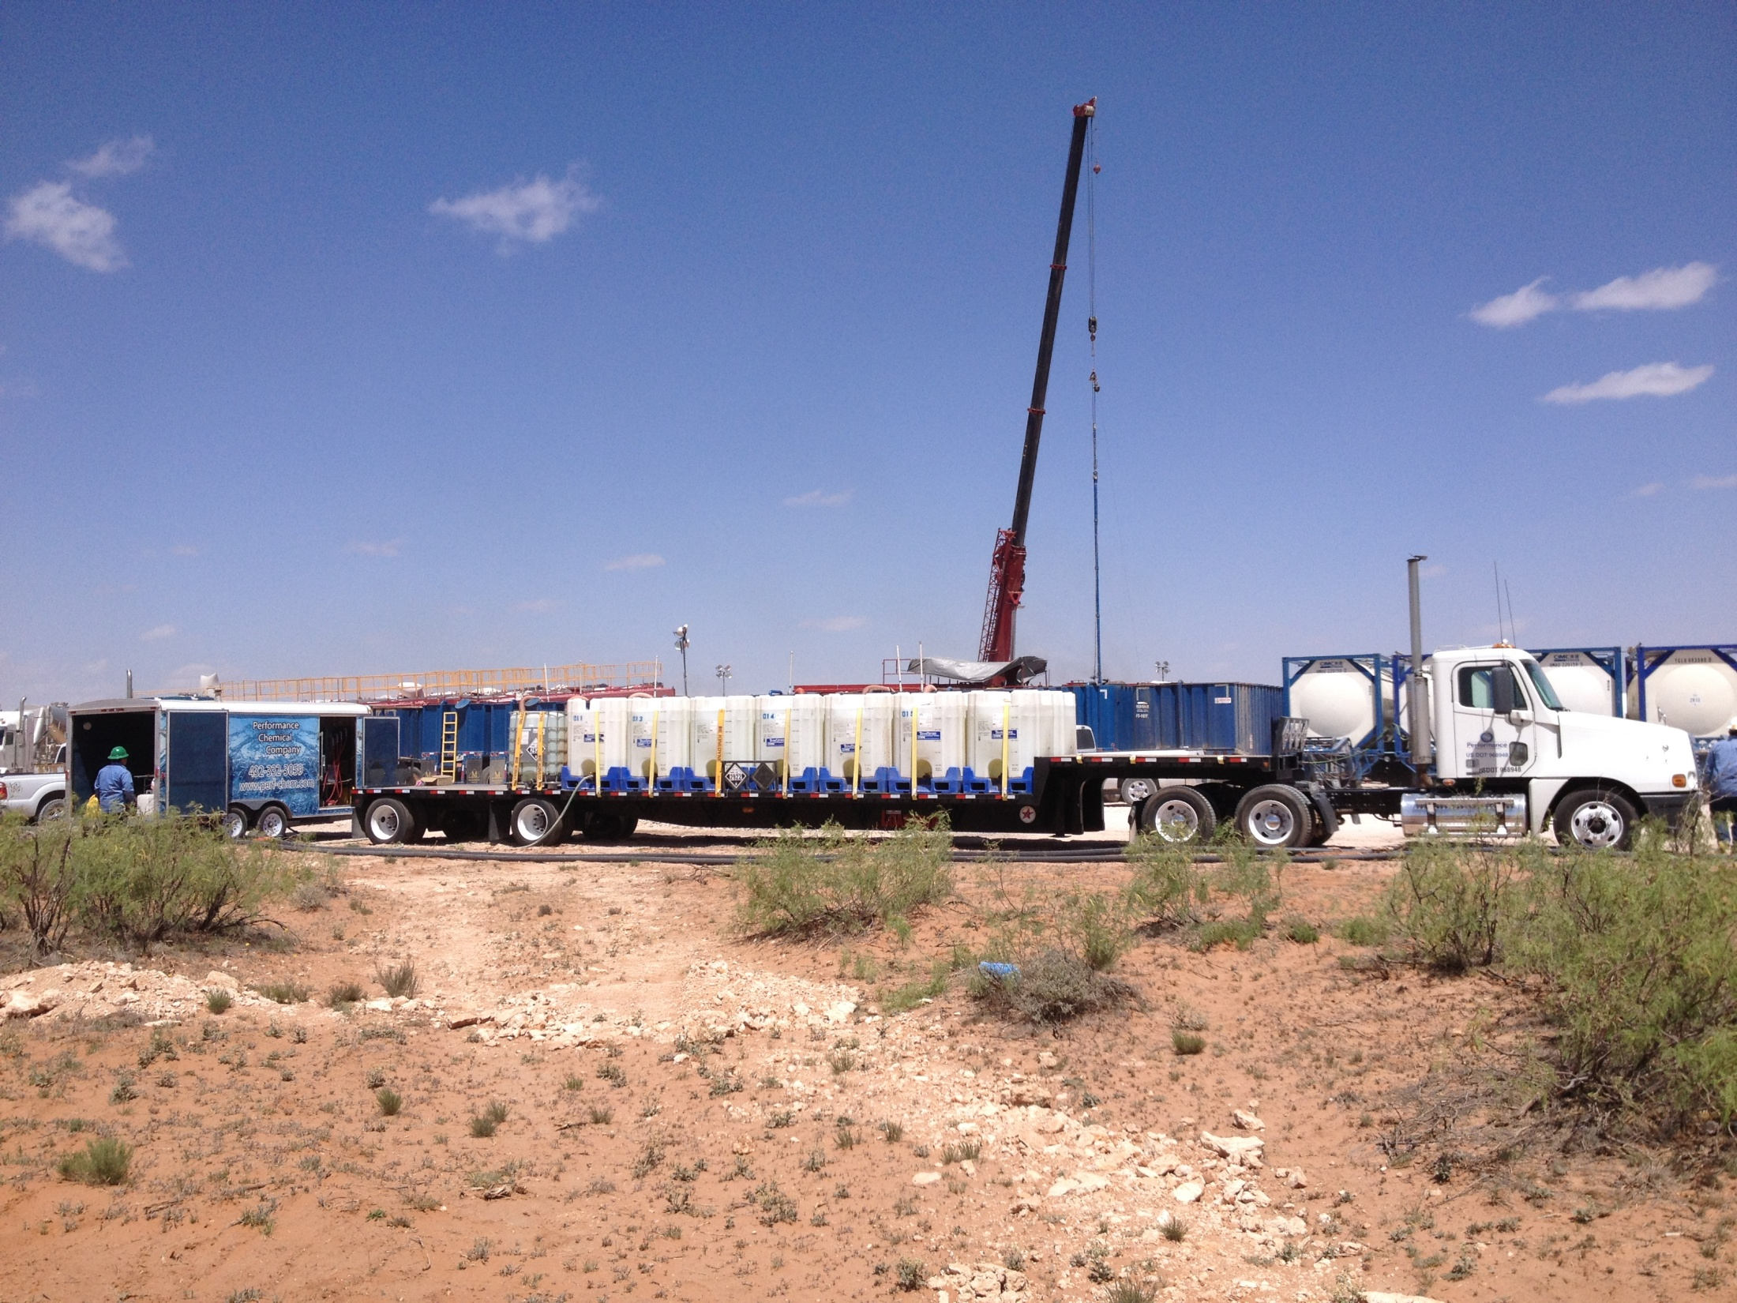
Multi-Purposed
Treatment applications in addition to Completions
Production – mixed in a slurry to be pumped down the casing
Remediation – pellet form to drop down casing or tubing
Pre-Frac of Horizontal on surrounding vertical wells
Preventing issues with Bacteria, Scale, Corrosion, Paraffin, Emulsion…

